Slide 1
Agenda
DEI – DEI Chair Larence Kirby “Kirby”

Slide 2
Diversity, Equity, and Inclusion (DEI): Let’s Take a Look
Dr. Larence Kirby
Chair, District 7630 DEI Committee
Dover Capital City Rotary

Slide 3
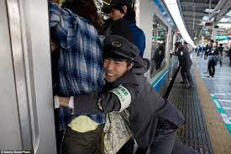
Diversity, Equity, and Inclusion (DEI)
What the Diversity, Equity, and Inclusion briefing is not!
Forced rules about what a
club will do

Slide 4
Diversity, Equity, and Inclusion (DEI)
What Diversity, Equity, and Inclusion
briefing is!
Opportunity to learn and
expand club knowledge

Slide 5
Diversity, Equity, and Inclusion (DEI)
Overview
District DEI Vision
Diversity
Equity
Inclusion
RI President’s Message
Way Ahead

Slide 6
Diversity, Equity, and Inclusion (DEI)
District DEI Vision:
To introduce its Clubs to the concept of DEI, to start a dialog on the importance of our Clubs to be inclusive, and to reflect the makeup of each Club’s community

Slide 7
Diversity
Diversity
Presence of differences that may include race, gender, religion, sexual orientation, ethnicity, nationality, socioeconomic status, language, (dis)ability, age, religious commitment, or political perspective. Includes populations that, have been, and remain underrepresented and / or marginalized in the broader society.

Slide 8
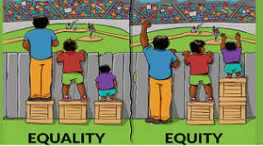
Equity
Equity
Promoting justice, impartiality, and fairness with the procedures, processes, and distribution of resources by institutions or systems. Tackling equity issues requires an understanding of the root causes of outcome disparities within our society.

Slide 9
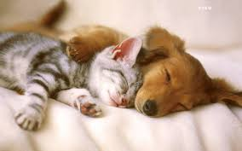
Inclusion
Inclusion
Outcome to ensure that diverse individuals actually feel and / or are welcomed. Outcomes are met when you, your institution, and your program are truly inviting to all. Ask are diverse individuals are able to fully participate in decision-making processes and development opportunities within an organization or group?

Slide 10
RI President’s Message
RI President’s Message
In Rotary, we celebrate DEI. It does not matter who you are, who you love, how you worship, whether you have a disability, or what culture or country you are from. What matters is that you want to strengthen communities and take action to create lasting change.
- Jennifer Jones

Slide 11
Way Ahead
Review your club’s knowledge, documentation, and commitment on DEI
Learn about underrepresented groups in your community, invite speakers, follow on social media
Understand DEI as positive and not an intrusive aspect of club life
Your Thoughts

Slide 12
Diversity, Equity, and Inclusion (DEI)
A diverse mix of voices leads to better discussions, decisions, and outcomes for everyone. ~ Sundar Pichai, CEO Google

Slide 13
Questions

